Slide 1
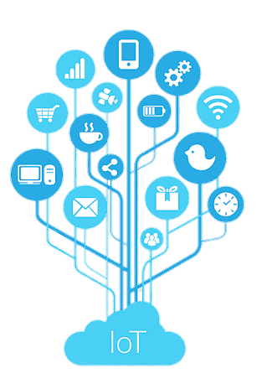

Risk Analysis and Support System for Children with ASD Using IoT
Presented by
Tahiya Akter
191002213
Susmita Debnath
191002076
Shartaz Yeasar Feeham
191002130
Supervised by
Md. Solaiman Mia
Assistant Professor
Department of CSE
Green University of Bangladesh

Slide 2
Introduction
Tools and technologies
Motivation
Data collection
Contents
Objectives
Evaluation
Literature Review
Limitations and challenges
Problem Description
Draft plan
Methodology
(System flow)
Conclusion
Methodology
(Algorithms)
References

Slide 3

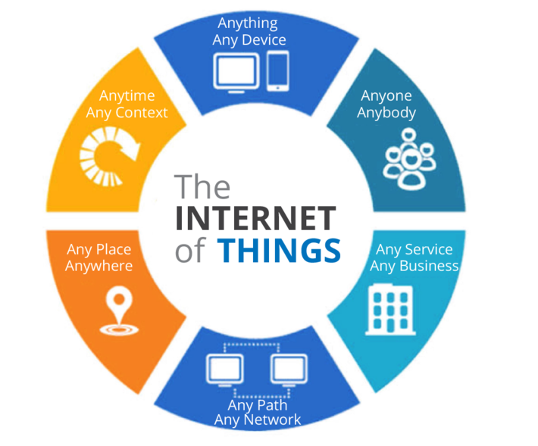
INTRODUCTION
Autism Spectrum Disorder (ASD) is a medical condition that occurs in children which affects communication and behavior of a kid.
Internet of Things (IoT) is simply a network of “things” that are connected to the internet so they can share data with each other.

Slide 4
MOTIVATIONS
Acquiring knowledge
Assuring safety
High availability of IoT
Those child are interested in technology
IoT’s previous success

Slide 5
OBJECTIVES
Aims for observing and analyzing risk
To examine the extent, range, and efficiency of IoT
To make a portable system that can assist parents
To build to build up a less costly, available, easy affordable system

Slide 6
PROBLEM DESCRIPTION
Autism children deserve to be observed without being treated like they are caged.
For being not observed they are getting in risk.
For being over observed they are being caged.
IoT has a big role in healthcare but not enough in this field.
The problem
Why
is it
What can not be done
What can be done
Acknowledgement system for parents.
Calming section for the child.
Risk analysis and safety assurance.
Can be a little costly for individuals.
Limited range.
Can catch up certain situations only.

Slide 7
LITERATURE REVIEW
Autism Support System using RFID Technology [1]
Identifies the location of ASD child and informs parents using RFID.
Working process
Pros
Old style common technology, low cost, available tools, easy to implement
Scope of improve-ment
Drawback
Backdated GSM, low range, RFID can only detect physical scenarios
Updated communication technology can be used, ther additional sensors can improve capability

Slide 8
LITERATURE REVIEW
A support system for autistic children using Internet of Things technology [2]
Uses advanced computing device and multiple sensors to observe the children and acknowledge parents
Working process
Pros
WiFi for communication, double computing device, calming section
Scope of improve-ment
Drawback
Costly & rare components, complex implementation, large device
Size can be reduced
Two way calming section could be added

Slide 9
LITERATURE REVIEW
Emotion Recognition of Autism Children Using IoT [3]
Introduces a strategy which utilizes thermal infrared (IR) information as special data to detect the facial expression of ASD child and analyze their status.
Working process
Pros
More friendly to the use, effective in social problematic scenarios, doesn’t use multiple sensors
Scope of improve-ment
Drawback
IR cameras can not detect behind obstacles.
Some ASD child make abnormal facial expressions.
Could be added some physical analysis devices.
Additional algorithms for more expression detection

Slide 10
LITERATURE REVIEW
Role of IoT and ML for autistic people [4]
This paper does a comparative study about the various systems currently being used for monitoring the autistic patients’ health and how it can be used for screening of autistic children.
Working process
Pros
Polysomnography, pulse rate sensor, eye tracking glasses
Scope of improve-ment
Drawback
Pulse rate sensor reader is placed inside the body. Sensitive and stationary.
Could use external sensing devices.
Acknowledgement systems can be added.

Slide 11
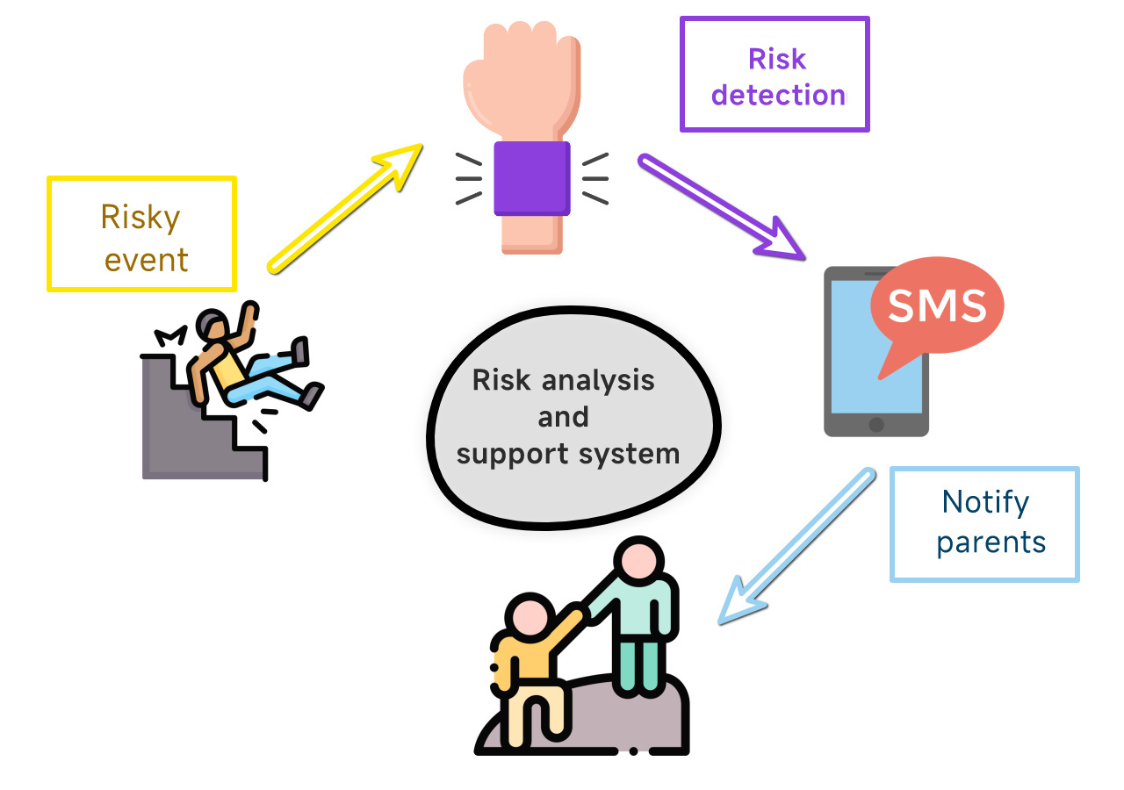
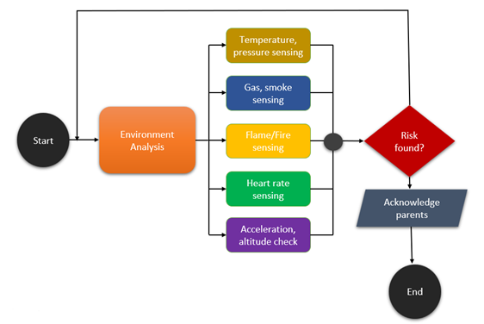
METHODOLOGY (SYSTEM FLOW AND ENGINEERING PROCESS)

Slide 12
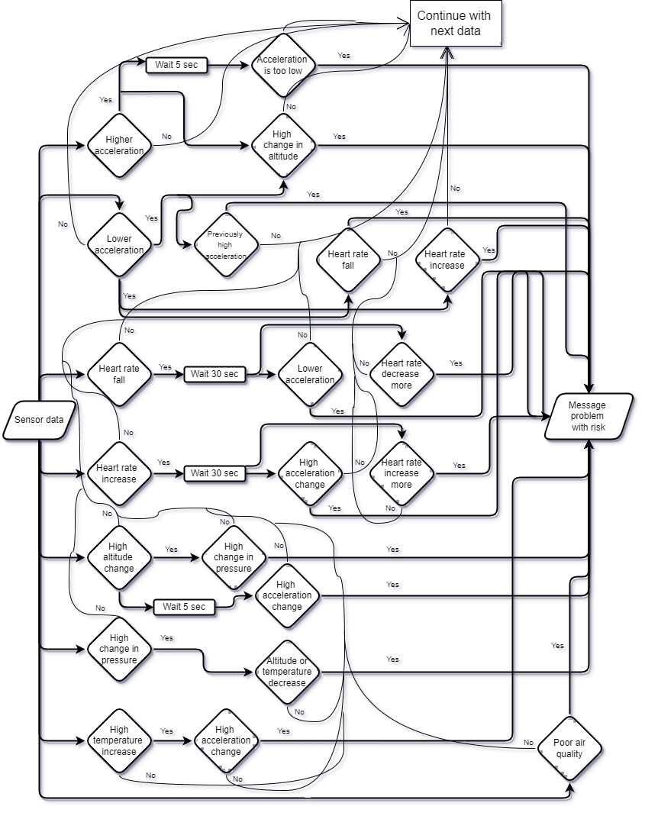
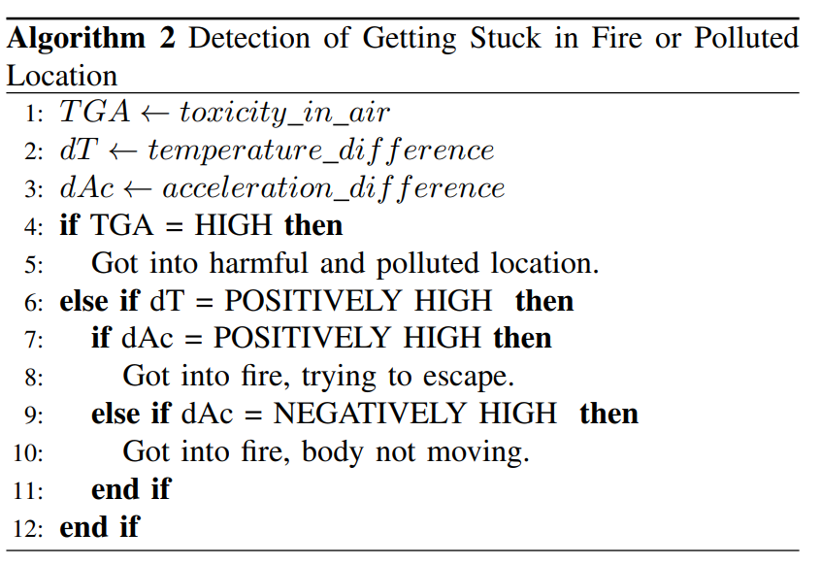
METHODOLOGY (ALGORITHMS)
The system uses the data in real-life logical conditions to determine a state. There are 5 different algorithms that handles a dozen types of input data; each one is connected with others’ yet independent. A cooperative flow shown here, is the backbone of the system.

Slide 13
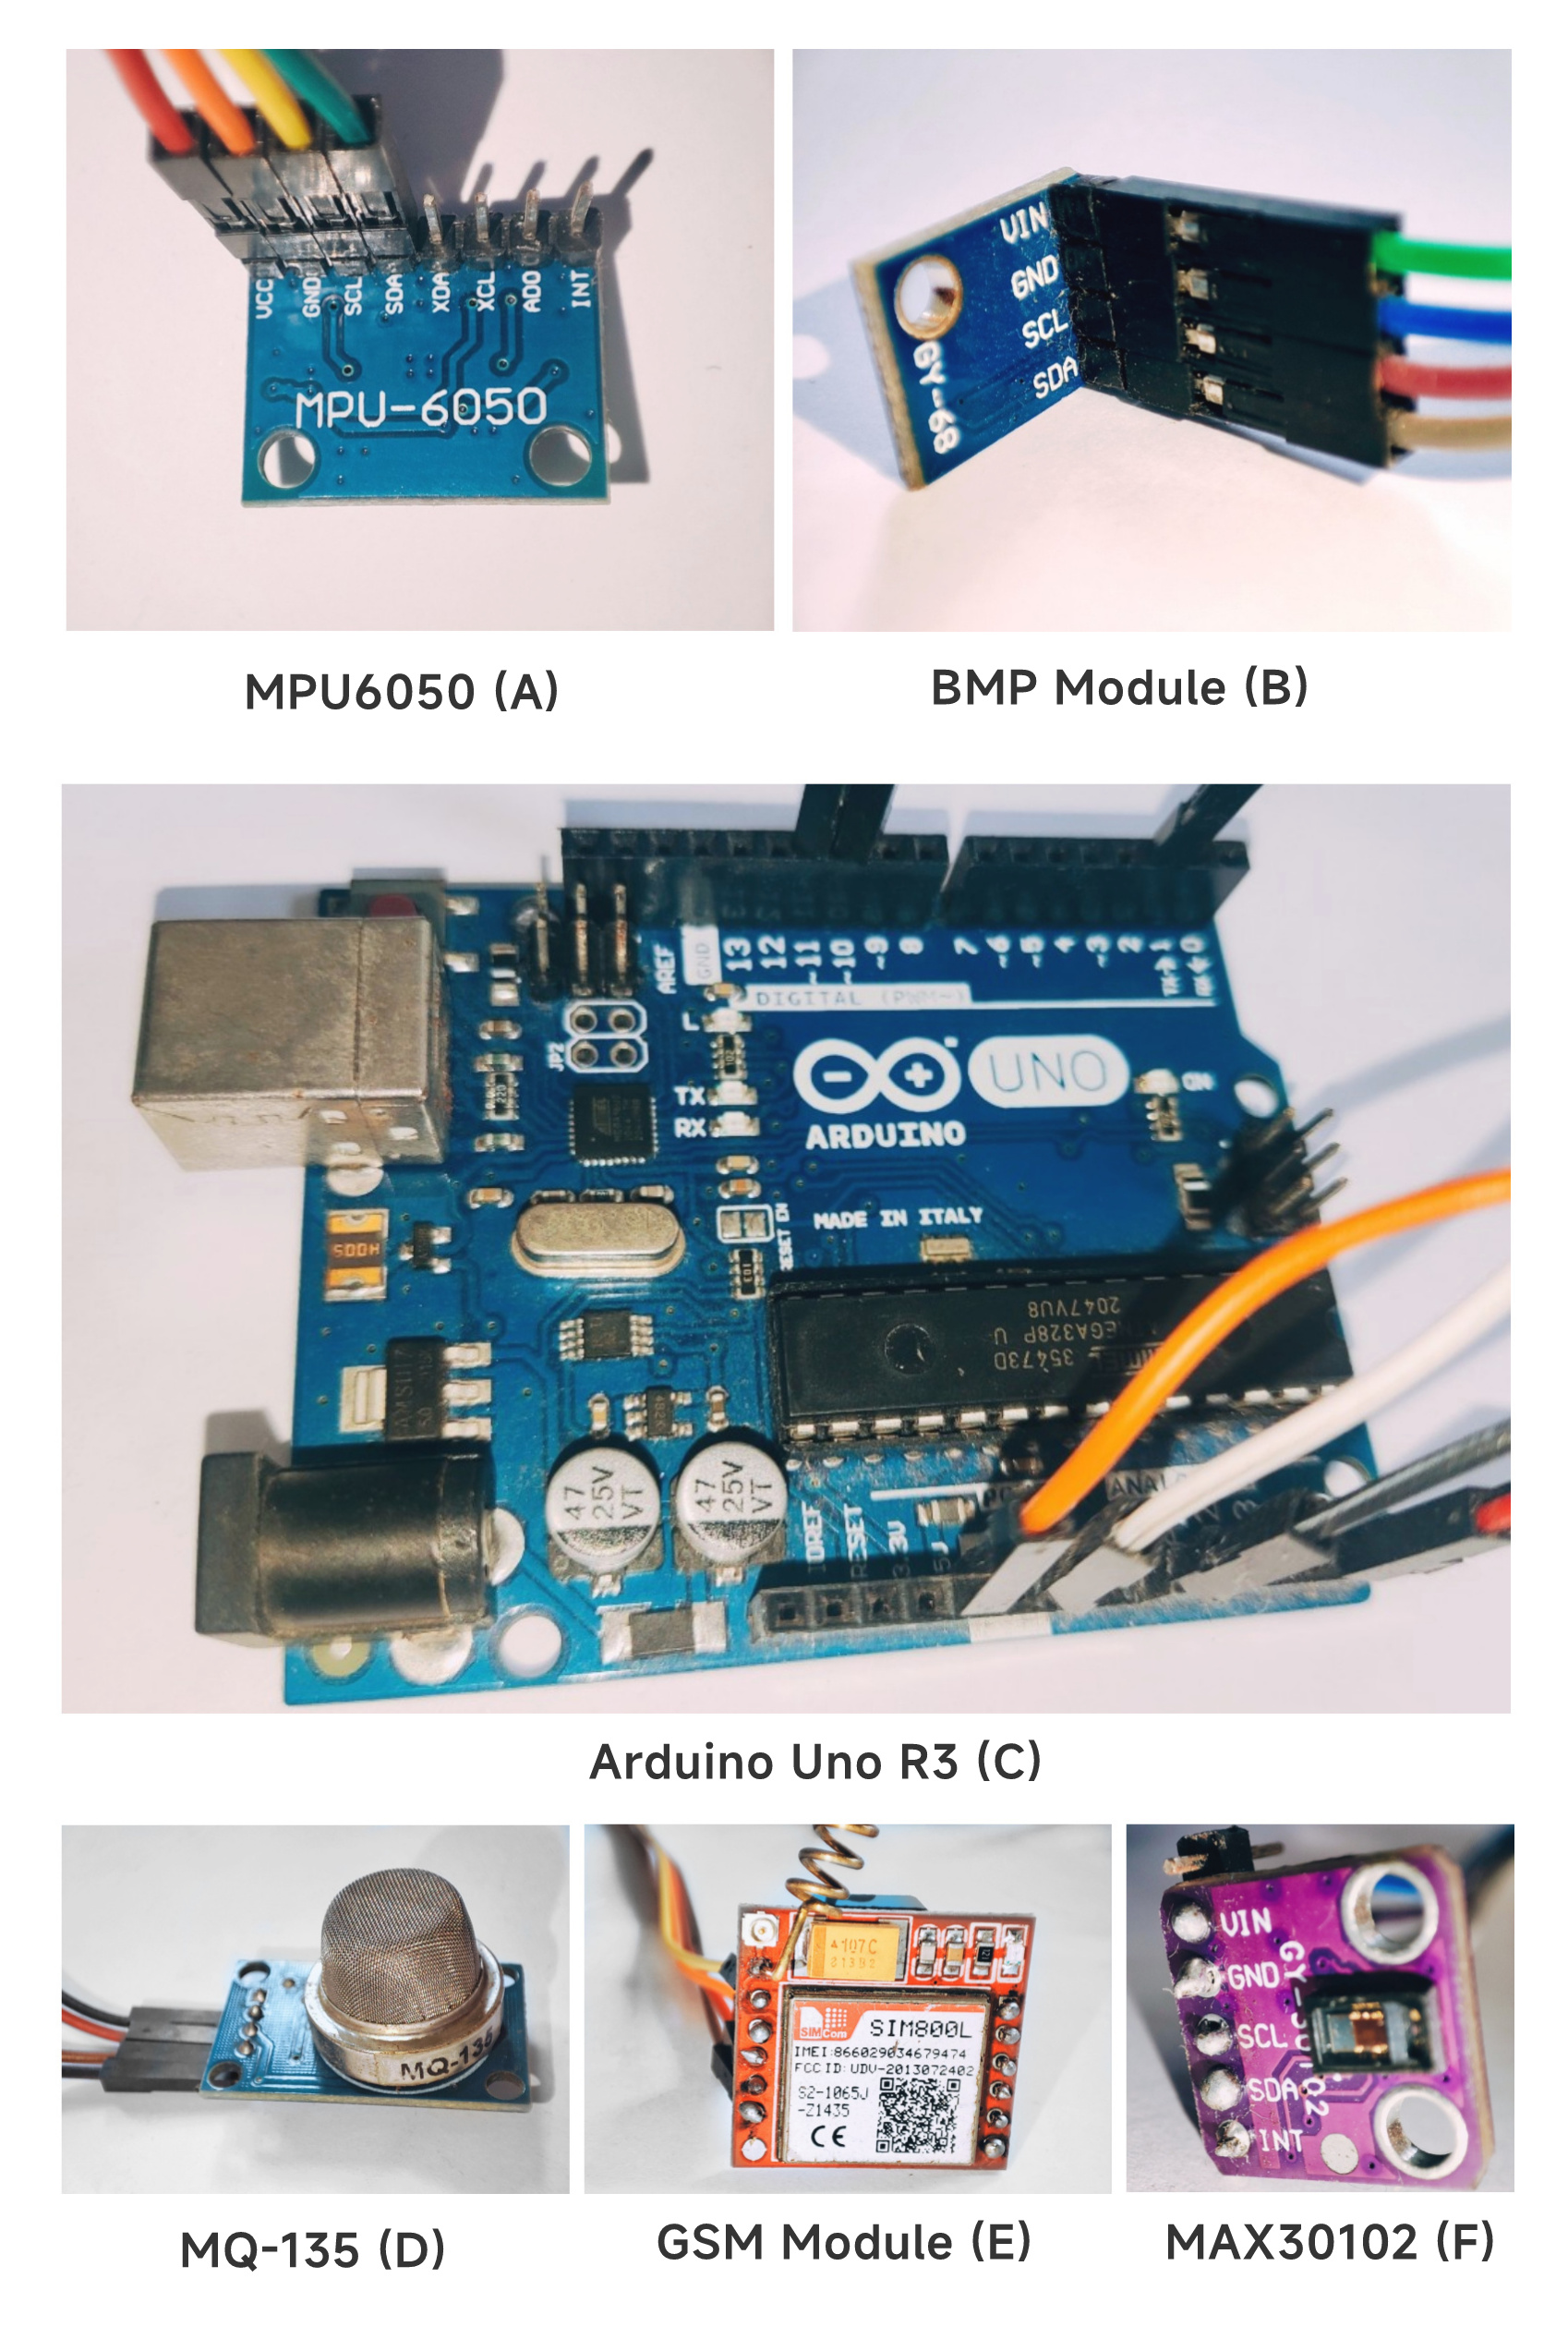
TOOLS AND TECHNOLOGIES
The proposed system consists of a processing device(Arduino Uno), a communication device (GSM module) alongside with 4 sensors, those are –
Accelerometer (MPU6050)
Gas (MQ135)
Barometric pressure(BMP-180)
Heart rate (MAX30102)

Slide 14
DATA COLLECTION
Designed prototype system relies on sensor based environmental information. Each sensor provides some certain types of real-time data.
Acceleration (3-axis), Angular rotation
Accelerometer sensor
Barometric pressure sensor
Temperature (nature), Pressure, Altitude, Humidity
Heart rate sensor
Gas sensor
Ammonia (NH3), Sulfur (S), Benzene (C6H6), CO2
Heart rate, Pulse oximeter, Temperature (body)

Slide 15
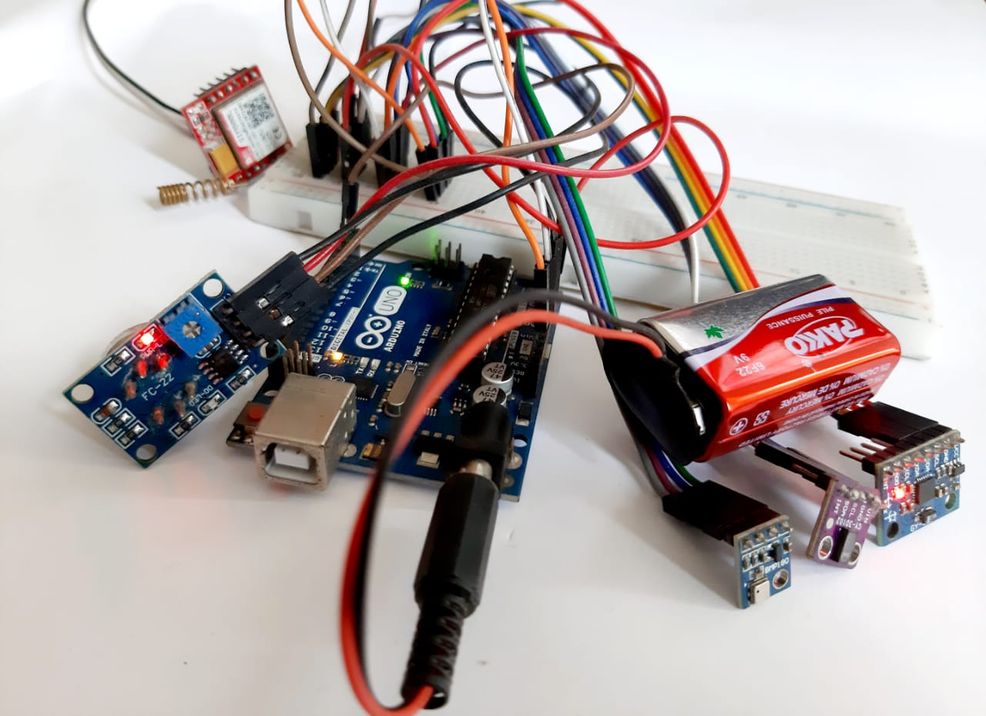
EVALUATION
The proposed system with mentioned algorithms were implemented and tested on both virtually generated data and real-time sensor data.

Slide 16
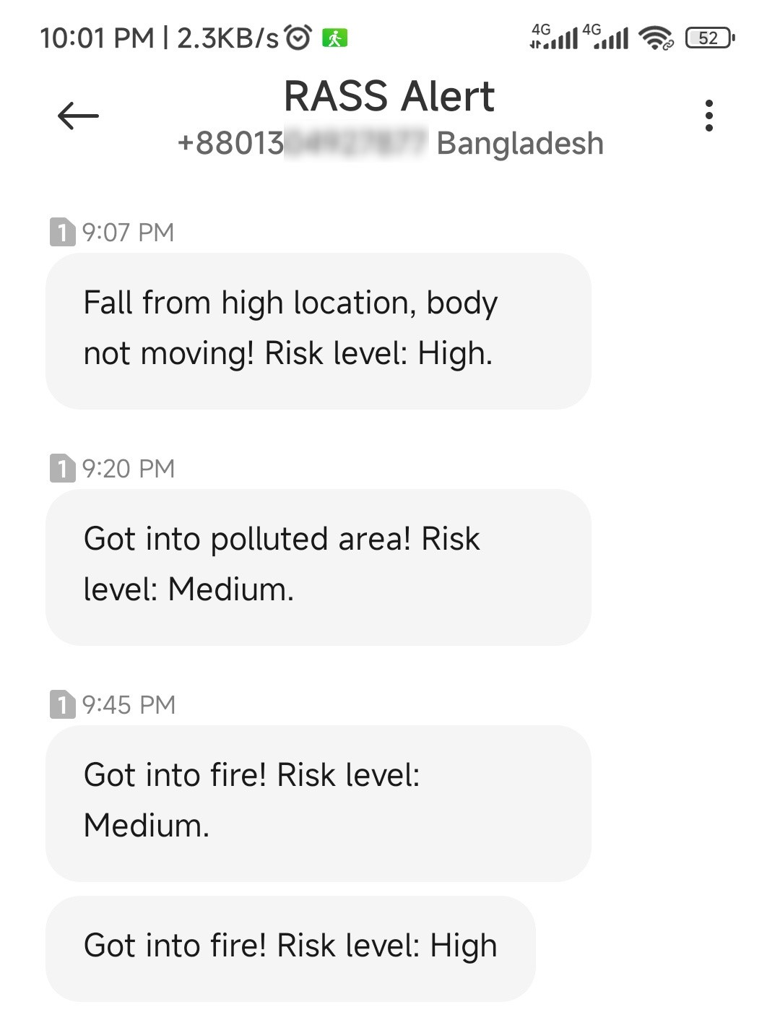
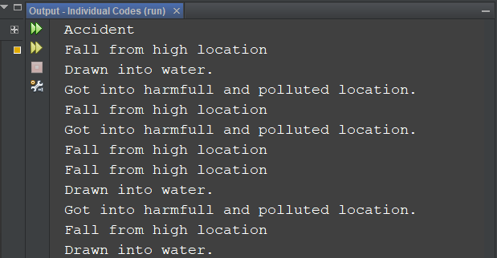
EVALUATION (cont.)
Test results of real-time sensor-data testing and virtually software-based testing.
Fig: test result with actual data
Fig: test result with virtually generated data

Slide 17
LIMITATIONS AND CHALLENGES
The system works as expected till now, but further evaluation may figure out more defects.
However some drawbacks found yet are –
Differentiating risky events vs regular events.
Limited risk detection.
Testing is hard and risky.
Failure propagation.
Hart rate sensor is not capable enough.

Slide 18
DRAFT PLAN (PROJECT PLAN)
Selection of research field
Interests, ideas, formulation of research topic
Research proposal, proposal presentation, idea discussion
Initial works
Similar works literature study
Data collection and analysis
Similar work limitation and solution
Starting phase
First draft and second draft preparation
Collecting components and implementation
Accuracy analysis, drawback finding, result analysis
Implement
Fixing previously found drawbacks
Additional works
Final draft writing, submission
Finalization

Slide 19
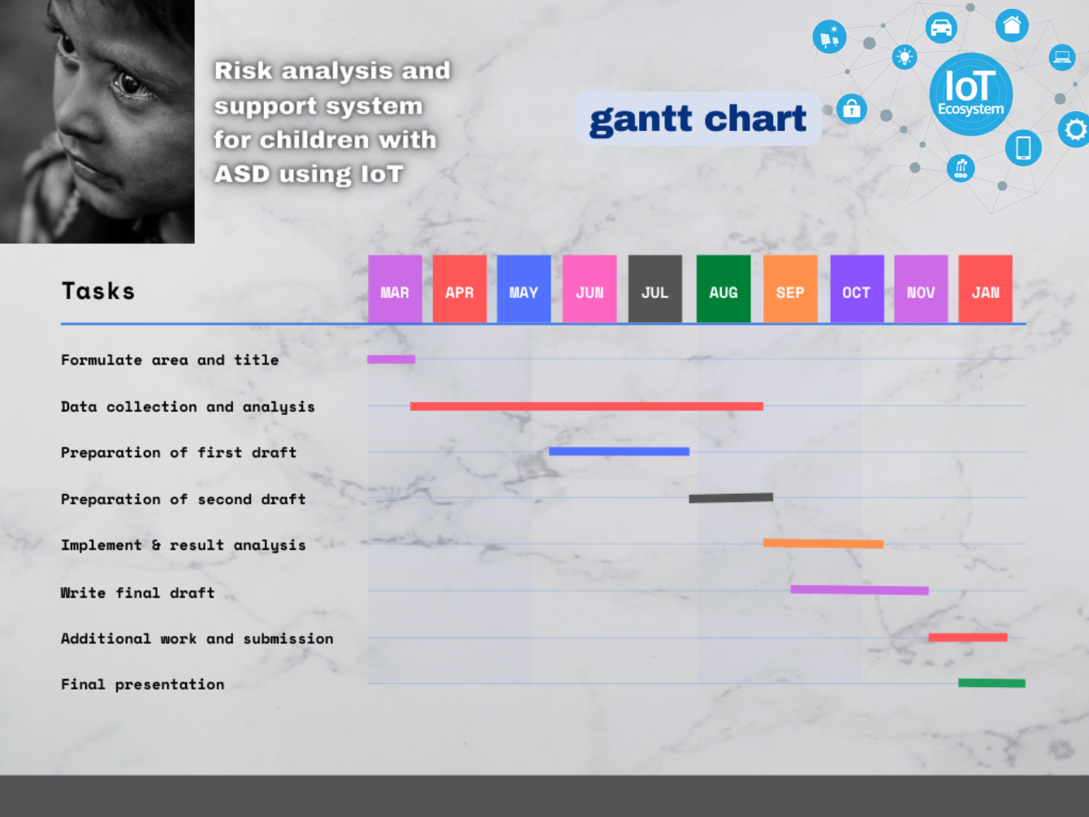
Fig: DRAFT PLAN (GANTT CHART)

Slide 20
DRAFT PLAN (BUDGET)
 | SI | COMPONENTS | COST PER UNIT(TK) | NUMBER OF UNITS | TOTAL COST | MOUSSELINES ADJUSTMENT
Computer | 1 | Arduino Uno | 1100 | 1 | 1100 | 1200
Sensors | 1 | BMP | 400 | 1 | 400 | 440
 | 2 | Accelerometer (MPU) | 400 | 1 | 400 | 440
 | 3 | Heart rate | 300 | 1 | 300 | 330
 | 4 | Gas and smoke | 250 | 2 | 500 | 550
Others | 1 | GSM module | 400 | 2 | 800 | 880
 | 2 | Battery | 400 | 1 | 400 | 440
 | 3 | Wires | 100 | - | 100 | 110
 | 4 | Extra | 500 | - | 500 | 550
Total |  |  |  |  | 4500 | 4950

Slide 21
CONCLUSION
ASD child problems and barriers
Availability and high capability of IoT devices
Risk analysis and acknowledgement systems
Multi situation catch up and communication
Software evaluation resulted better than hardware
Hard to test

Slide 22
REFERENCES
[1] A. S. Agnal, S. Janani, C. Maneesha and K. Ramya “Autism Support System using RFID Technology,” Int. J. Engineering and Advanced Technology, vol. 9, no. 1, pp. 4706-4710, 2019.
[2] N. M. Abdullah and A. F. A. Allaf, “A support system for autistic children using Internet of Things technology,” 2021 Int. Conf. Advanced Computer Applications (ACA), pp. 51-56, 2021.
[3] K. Lavanya, S. M. Anitha, J. Joveka, R. Priyatharshni and S. Mahipal, “Emotion recognition of autism children using IoT,” Int. J. Applied Engineering Research, vol. 14, no. 6, pp. 106-111, 2019.
[4] S. Dedgaonkar, R. K. S. Bedi, K. Kothari, R. Loya and S. Godbole,“Role of IoT and ML for autistic people,” Int. J. Future Generation Communication and Networking, vol. 13, no. 3, pp. 773–781, 2019.

